Slide 1

Spooky Quiz
Software Engineering 2 Final Project
~
Noah Baker
Jakob Legere
Riley Meyers

Slide 2
Overview
Introduction
UML Class Diagrams
System / User Flow
Design Patterns
Conclusion

Slide 3
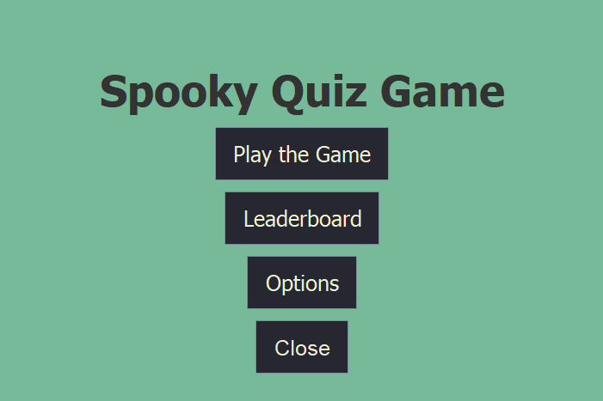
Introduction to Spooky Quiz
Quiz game created in Java
Haunted by an evil spirit that causes questions to occasionally act up
Complete all the questions in the quiz in record time and go for the high score

Slide 4

Purpose & Function
Create a system that demonstrates our understanding of design patterns
Choose patterns that made our code easy to modify, as well as add extra features and content
Make something fun :)
Leaderboard
3 Categories of Questions
Dynamic Scoring System
Random Effects applied to quiz questions

Slide 5

Programming Language
Why Java?
The OOP language
Strictness - Doesn’t let us get away with anything
We all had a little knowledge.
Lots of examples for design patterns; very documented

Slide 6
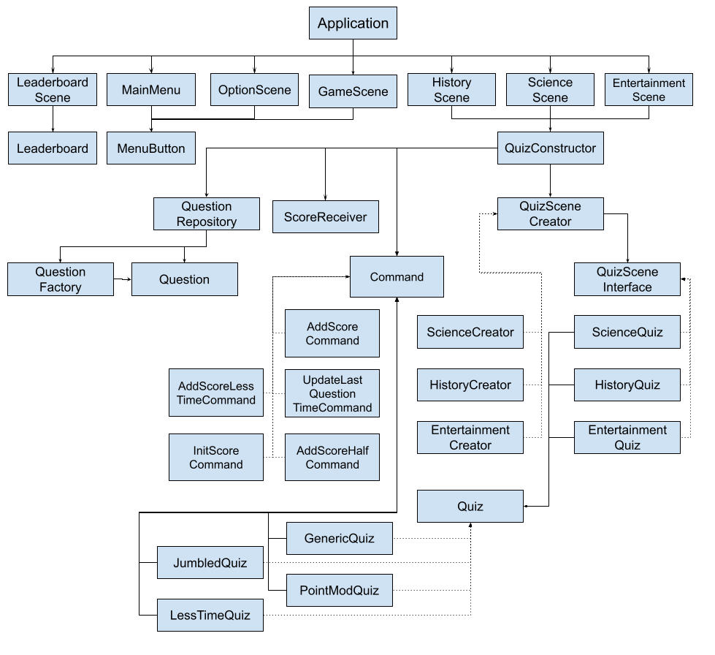
System Model

Slide 7
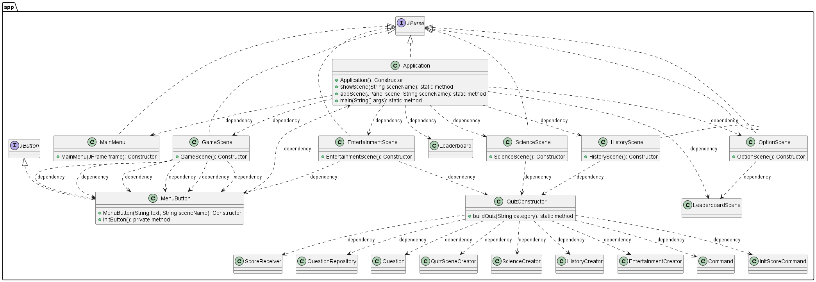
App Package

Slide 8
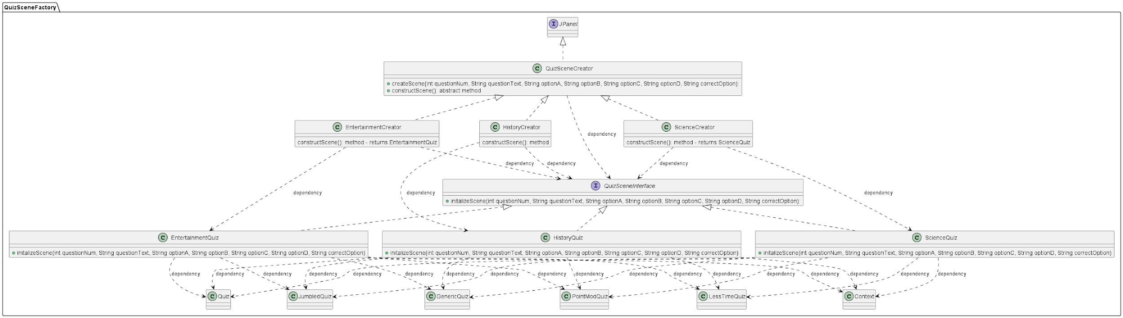
QuizSceneFactory

Slide 9
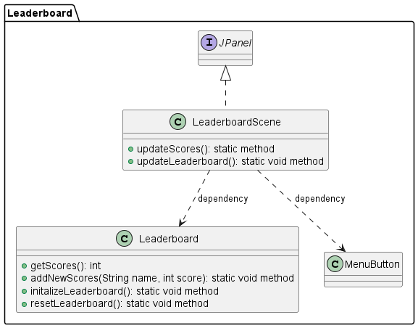
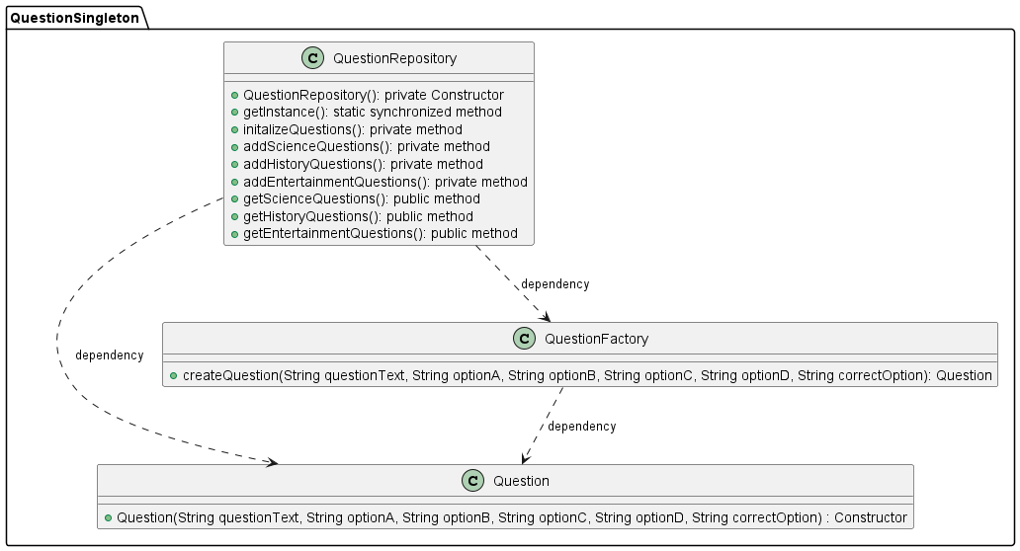

Slide 10
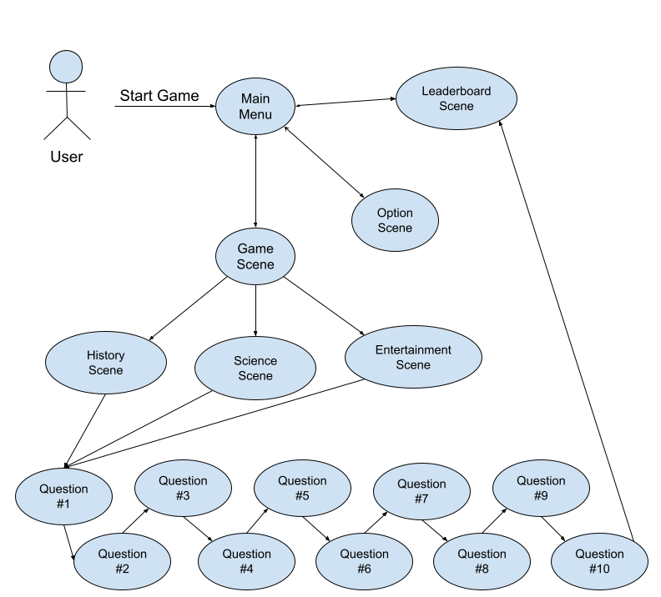
User Flow

Slide 11
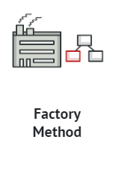
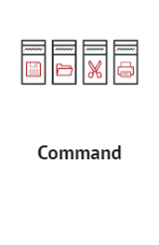
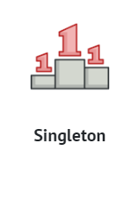
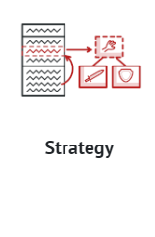
Design Patterns

Slide 12
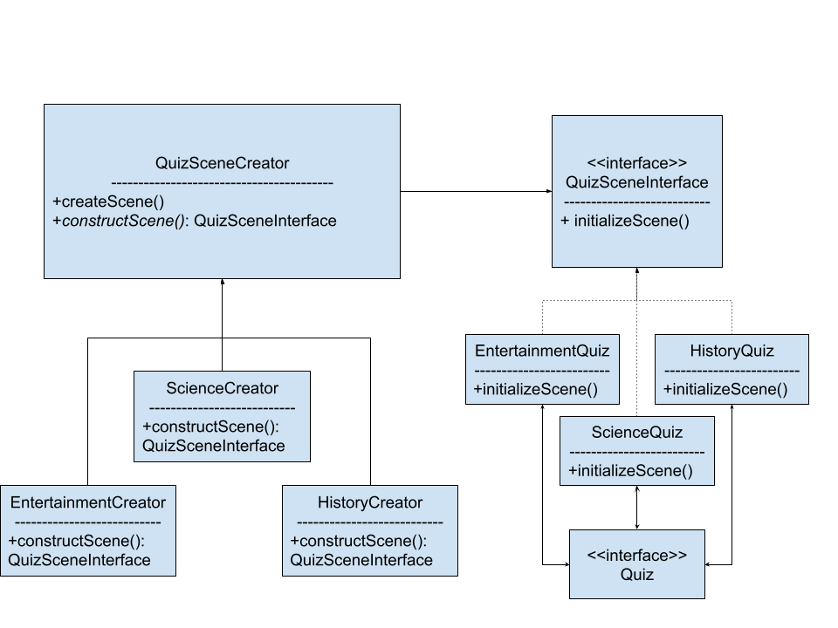
Factory Method
-Why did we choose this?
-Purpose
- How did we do it?
- Benefits

Slide 13
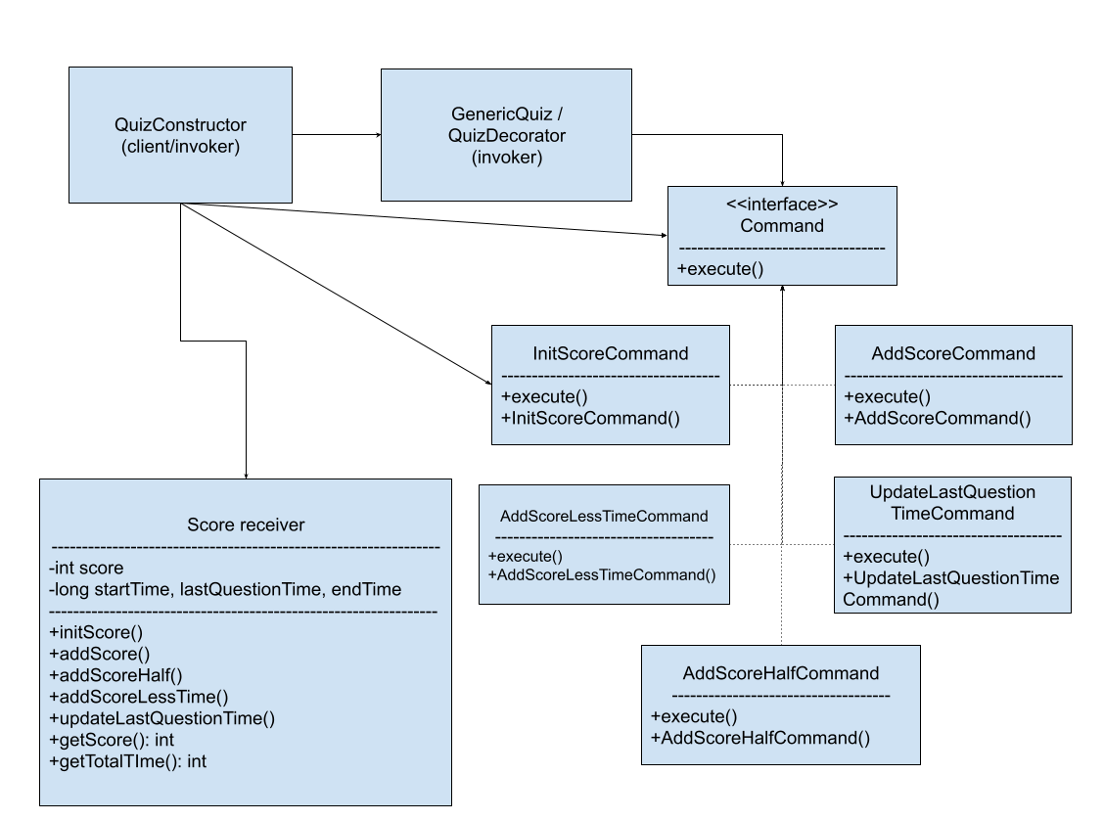
Command
-Why Command? (over observer?)
- How did we implement it?
- Scoring

Slide 14
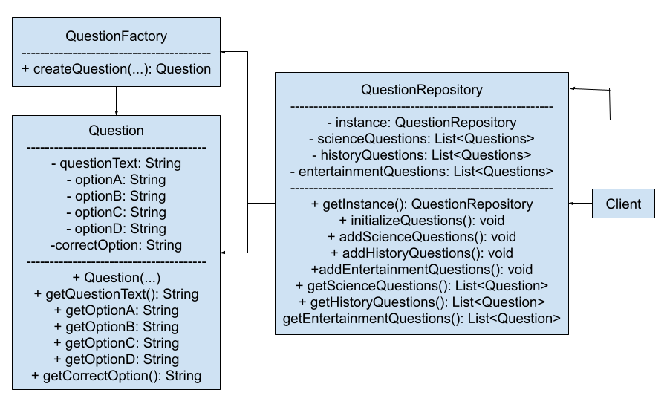
Singleton
Generates Questions as well as Question lists for each category
Singleton ensures that only one instance of the questions lists exists at once
QuestionRepository also contains the getter methods for the question lists
Gives us a consistent and reliable way to call in the questions

Slide 15
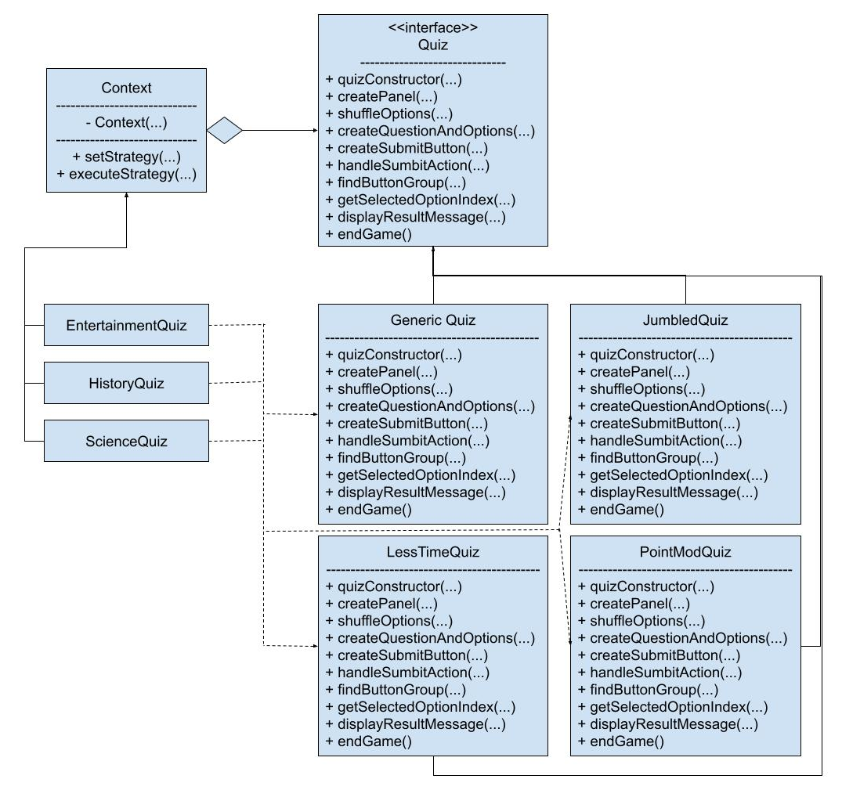
Strategy
Used to dynamically alter the traits of individual questions, giving them their “Haunted” traits
Why Strategy over other patterns?
We considered both Template and Wrapper patterns
Utilized Strategy in the end because it was more dynamic, worked at runtime, and was based around modifying object behaviour
4 Types of Concrete Strategies (Or question variations) exist in our final code

Slide 16

Conclusion - Summary
Difficult at first
We now appreciate OOP a lot more
We realize how programming in this way is beneficial for the long-term maintenance and scalability of any program
Adding the later design patterns were easier with the solid foundation using our previous design patterns.

Slide 17
Conclusion - Future Work
UI design
More categories/Questions (thanks design patterns!)
More haunted aspects
QOL on details - input checking, more options, audio, etc
Extending factory pattern to abstract factory pattern

Slide 18
Conclusion - Final Thoughts
Some design patterns were a straightforward pick for us due to our use of Swing.
Factory for Jpanels
We needed to stay flexible
Some patterns that we thought looked good on paper, didn’t work with our existing system well when trying to create UML diagrams.
We learned a valuable lesson about design patterns, and how the upfront short-term time commitment to ensuring quality code is written is well worth it for the long term maintainability and scalability of the codebase.

